Slide 1
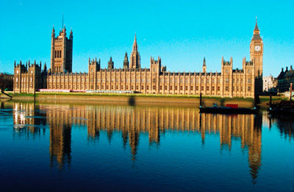
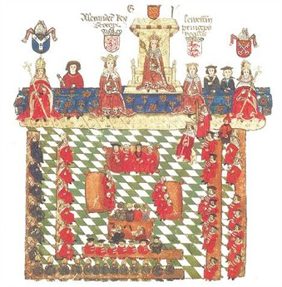
Section 3
Parliament Triumphs in England

Slide 2
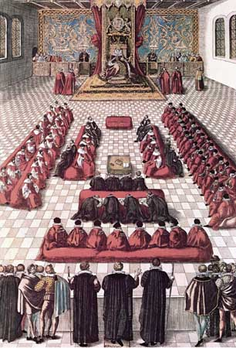
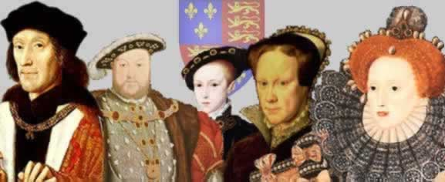
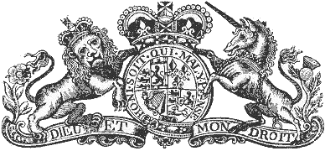
ENGLAND did NOT develop an ABSOLUTE STATE
From 1485 to 1603 England was ruled by the Tudor Dynasty
They believed in Divine Right but SHREWDLY recognized the values of GOOD RELATIONS WITH PARLIAMENT

Slide 3
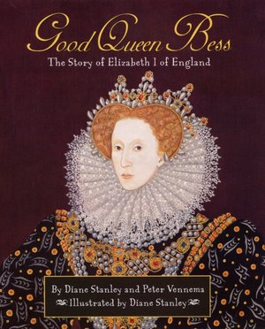
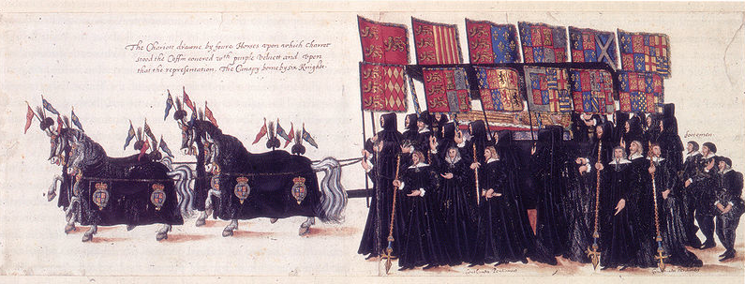
ENGLAND did NOT develop an ABSOLUTE STATE
Queen Elizabeth consulted and controlled Parliament
She willingly called Parliament into session to enact her policies
“Good Queen Bess” - a popular and successful ruler

Slide 4
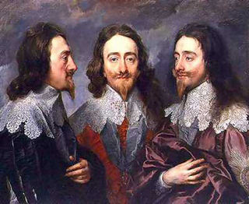
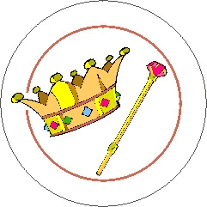
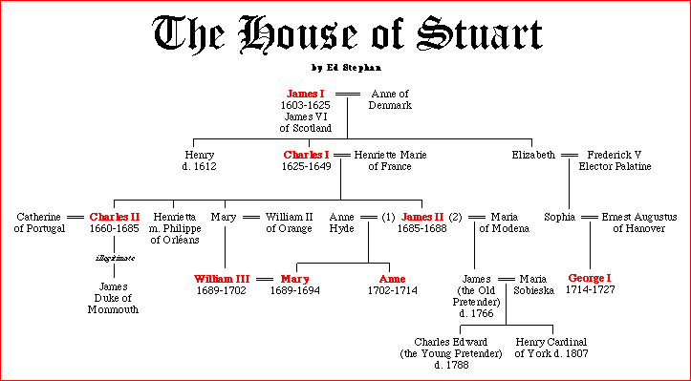
The Stuart Monarchy begins in 1603 (Elizabeth has no direct heir)
Begins a century of Revolution - pitted Stuart Monarchs against Parliament

Slide 5
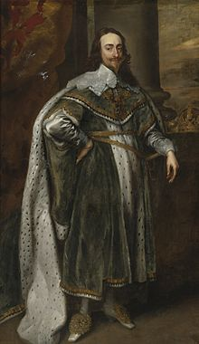
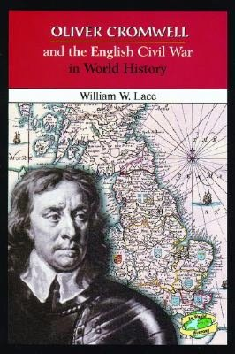
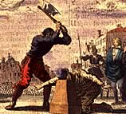
1625 - Charles I inherits the throne - wants to rule as ABSOLUTE MONARCH
Imprisoned foes without a trial –
Parliament forced him to sign the Petition of Right
Dissolved Parliament - ignores them for 11 years
ENGLISH CIVIL WAR breaks out (Roundheads - Cromwell)
Charles I EXECUTED in 1649

Slide 6
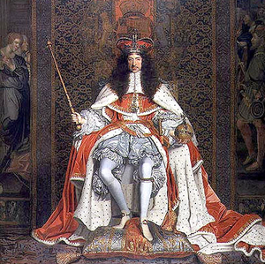
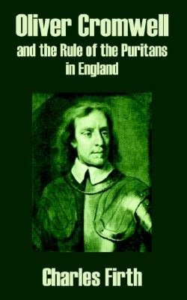
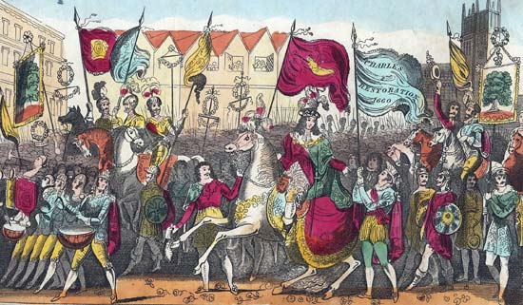
Cromwell made England a Commonwealth under Military Rule
Made England a Puritan Society- very strict
He dies in 1658 - people sick of military rule –
Parliament brings back the King, Charles II from exile - this is the RESTORATION
Charles was a popular ruler
He restored the Church of England (ANGLICAN) but tolerates all religions

Slide 7
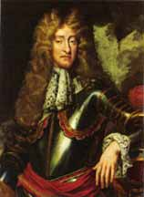
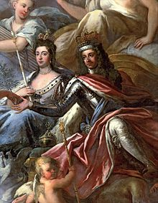
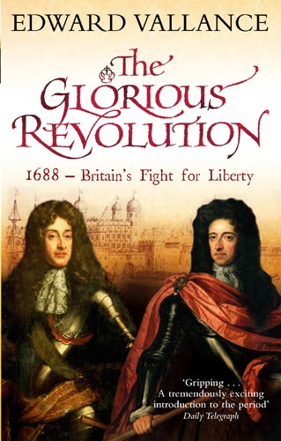
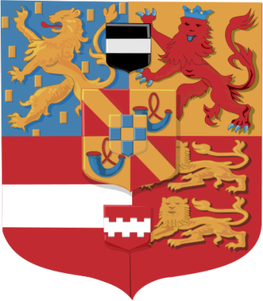
Charles dies, James II inherits - Parliament fears he will bring back the Roman Catholic Church
Parliament invites James’ protestant daughter and her husband to rule - WILLIAM and MARY of ORANGE land with their armies - James flees
This bloodless overthrow becomes known as THE GLORIOUS REVOLUTION

Slide 8
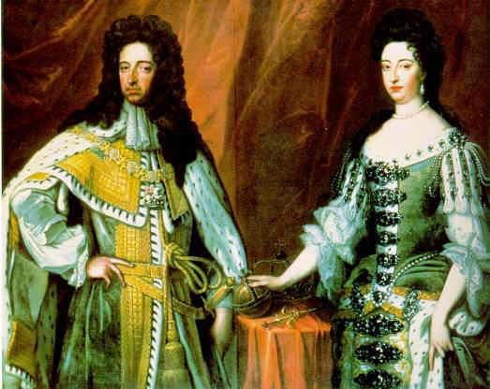
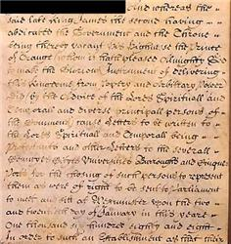
Before being crowned, William and Mary had to sign the ENGLISH BILL of RIGHTS - which insured the superiority of Parliament over the monarchy
Monarch had to call Parliament into session regularly - Monarch could not interfere in debates or suspend laws - barred Roman Catholic church from sitting on the throne
England ‘s government becomes a limited monarchy - constitution or legislative body limits the monarch’s powers

Slide 9
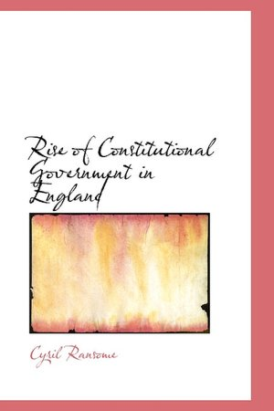
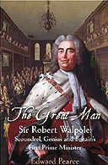
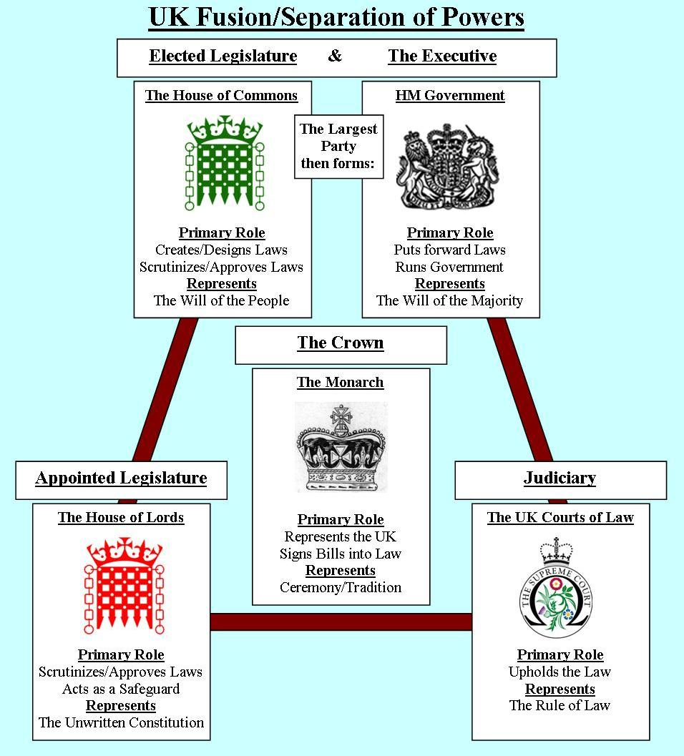
The Evolution of Britain’s CONSTITUTIONAL GOVERNMENT – a government whose power is defined & limited by laws
Political parties emerge: Tories & Whigs
The Cabinet System: a few parliamentary advisors set policy
Prime Minister: Head of the cabinet; leader of major party in House of Commons; chief official in British government

Slide 10
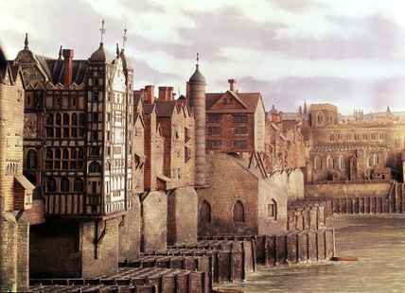
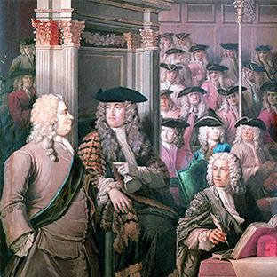
Society Still Ruled by a Few
Even with Parliament, Britain still ruled by a powerful few –= an OLIGARCHY
was not democratic
Landowning aristocrats were “natural” ruling class = House of Lords
Wealthy and rich business leaders = House of Commons
Very few could vote – only male property owners
However – a strong middle class was evolving: merchants, craftspeople, manufacturers = controlled affairs in towns & cities

Slide 11
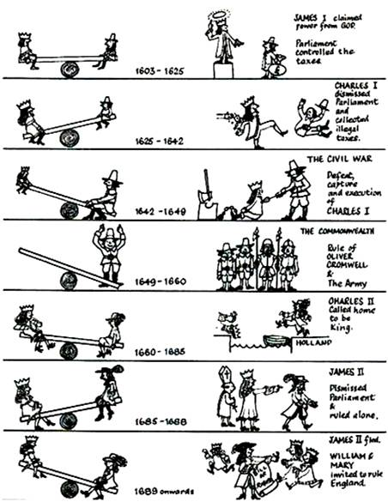
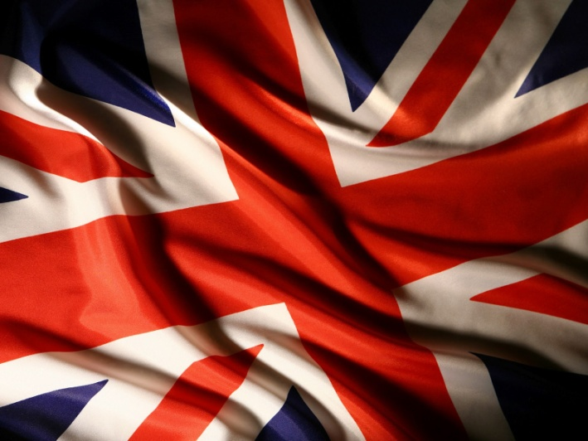
And now…… for a quick recap…

